Slide 1
Centralized or Decentralized Organization
Business Intelligence & Analytics

Slide 2
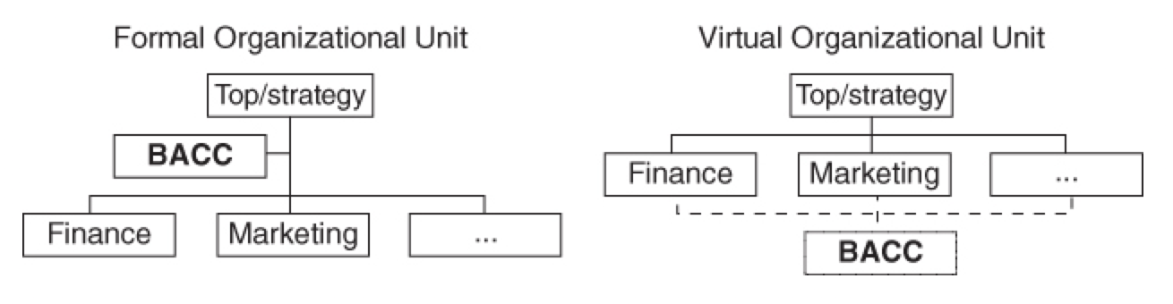
BACC organizational strategies
BACC set up as an organizational support unit
Generally reports directly to the strategic function of the business
BACC established as a virtual organization
Smaller strategic roll
Primarily setup to function at an operational level
Should facilitate synergies at the departmental level

Slide 3
BACC organizational strategies
BACC set up as an organizational support unit
Generally reports directly to the strategic function of the business
BACC established as a virtual organization
Smaller strategic roll
Primarily setup to function at an operational level
Should facilitate synergies at the departmental level
What are we trying to achieve?

Slide 4
What is our goal?
Strategy?
Performance?
Both?
Notes:
Should do one of the three otherwise we have lost track of what we’re trying to do.

Slide 5
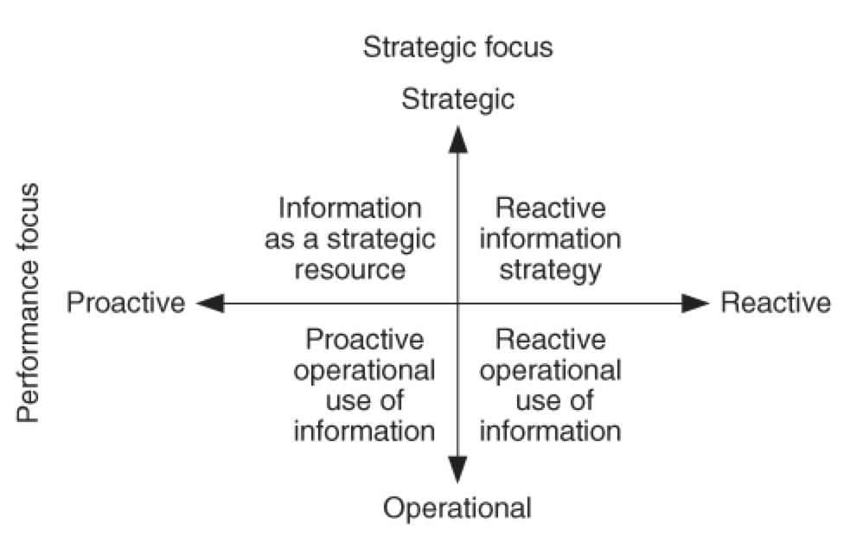
Performance and Strategy
Notes
Contrast Operational vs Strategic
Proactive vs reactive
Performance focus means focusing on being proactive

Slide 6
Proactive vs reactive
Reactive
Processes setup to make requests of analysts
Users ”order” information/knowledge
Agreed upon deadlines
Not great for realtime or creative projects
Deadlines tend to be set in days or weeks
The business may use the BA function less and less over time
Reduces value of analytic team and reduces value of the data warehouse
Proactive
To be proactive, make sure analysts participate as a part of the team
This means analysts can advise on which data will deliver optimum results
Constitutes an ongoing briefing of the analyst with regard to what is important
Answers will be derived quicker
Answers will be relevant more often the first time
Requires a special kind of analyst

Slide 7
Proactive vs reactive
Proactive
To be proactive, make sure analysts participate as a part of the team
This means analysts can advise on which data will deliver optimum results
Constitutes an ongoing briefing of the analyst with regard to what is important
Answers will be derived quicker
Answers will be relevant more often the first time
Requires a special kind of analyst
Notes
Means analysts must be included in the work teams that draw on their resources
A decentralized BACC is sufficient if a proactive operational group is desired
Ensured direct access to end-users
Are involved in the development of value-creating processes

Slide 8
Closer integration with strategy

Slide 9
Closer integration with strategy
Notes
If a closer integration with strategy is desired -> strong case for creating a formal organizational entity
Primary argument is that the BACC has a place on the executive team in the form of the manager/director of the analytics group
Director has the formal authority to prioritize strategic tasks
Allows BACC to detach from operational needs when necessary
Focuses IT resources on providing value instead of focusing on maintenance
Goal of BACC management to identify where the company is now and where it would like to be (reference to 4 scenarios from chapter 2)

Slide 10
Maturity assessment
Technical elements – do we possess the technology necessary to mature?
People elements – do we have the right competencies and resources?
Business process elements – are we organized in the right way to meet our objectives?

Slide 11
Note about analytics reporting to IT
Turns the value chain upside down
Analysts report only what is available in the data warehouse
When analysts acts in a grey area where should their loyalty be placed?
Analyst’s role to challenge the data warehouse

Slide 12
Centralized or Decentralized
Decentralized if optimizing day-to-day operations, need to be close to decision makers
Centralized if desire a tighter integration between strategy and how information is used
Notes:
At Domo we have combination of the two methods.

Slide 13


